Slide 1
London Housing Prices
December 2020

Slide 2
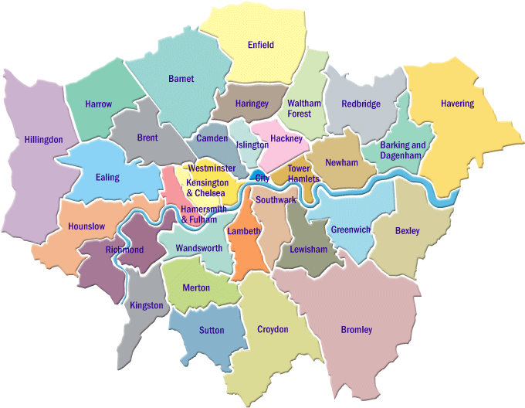
“Which boroughs of London have seen the greatest increase in housing prices, on average, over the last two decades?”

Slide 3
Data Sourcing
Source: London Datastore
Free, open-source data-sharing portal for London-oriented datasets
https://data.london.gov.uk/
Dataset: UK House Price Index
Captures changes in the value of residential properties using sales data collected on residential housing transactions
url_LondonHousePrices

Slide 4
Clean & Transform
Cleaning
.reset_index()
Transforming
Transpose (columns to rows)
Melt (wide to long)
.info(), .describe()
.dropna()
.rename()
Add Year & Area Type

Slide 5
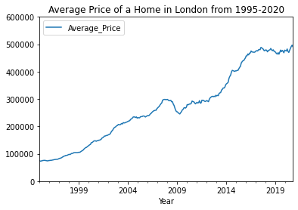
Exploration
Average prices increased (~linearly) until 2008 housing market crash
Market appears to recover to pre-crash trajectory around 2018

Slide 6
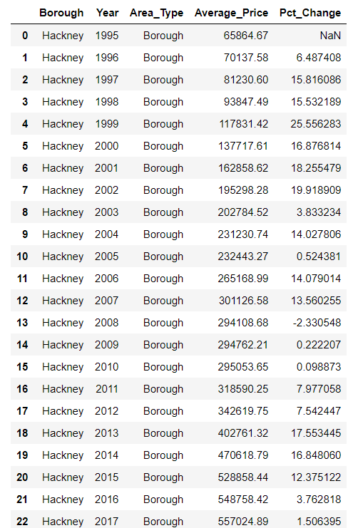
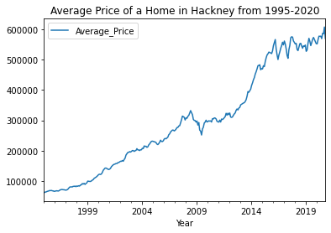
Borough
Exploration
Individual borough trends closely followed London
Prices consistently increased
Year-over-year percentage changes were variable

Slide 7
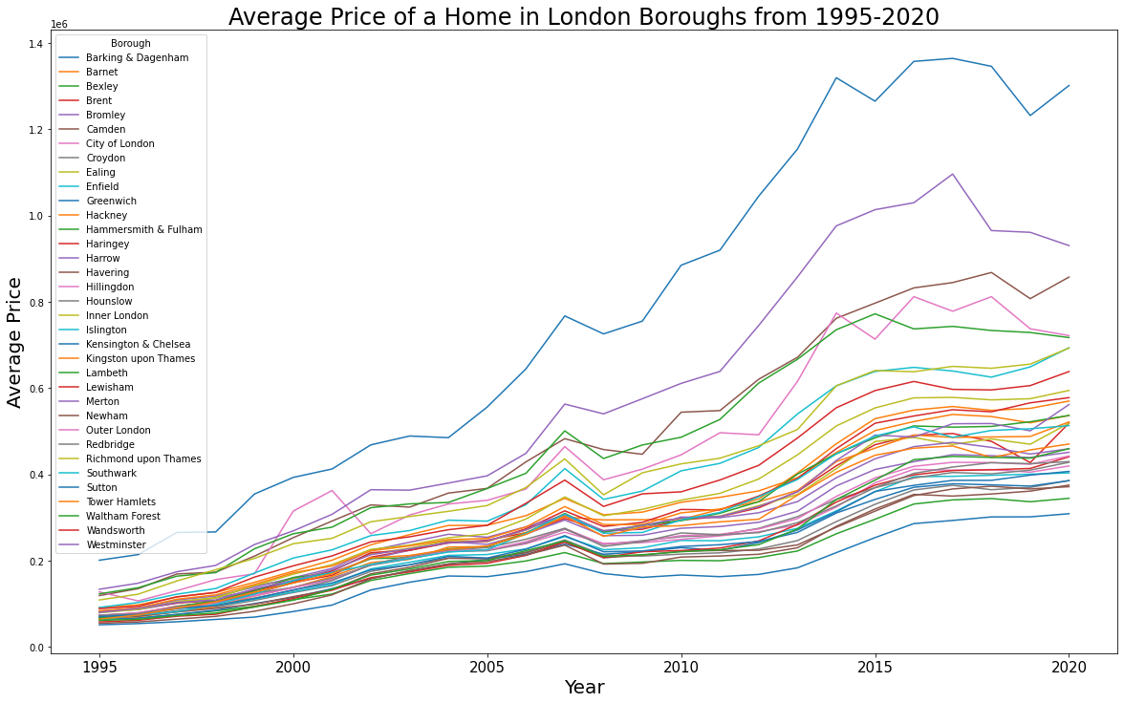
Average Price of a Home in London Boroughs
Notes:
Similar pattern
Range tighter and spread over the last two decades (gap between least and most expensive significantly larger)

Slide 8
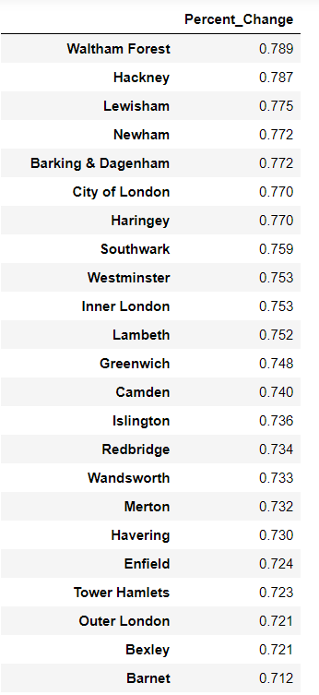
Modeling
Identify the percentage change between 1999 & 2019
Compare change ratio across boroughs

Slide 9
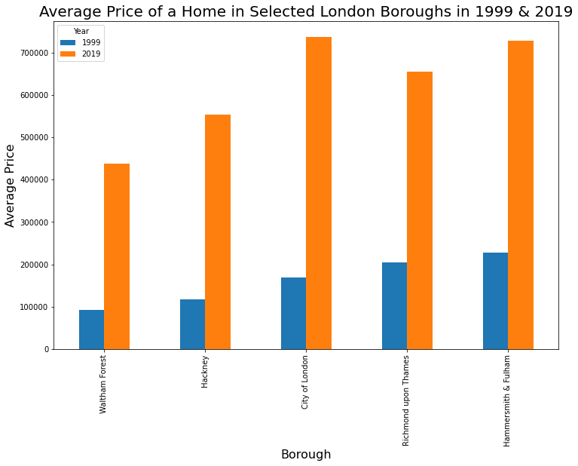
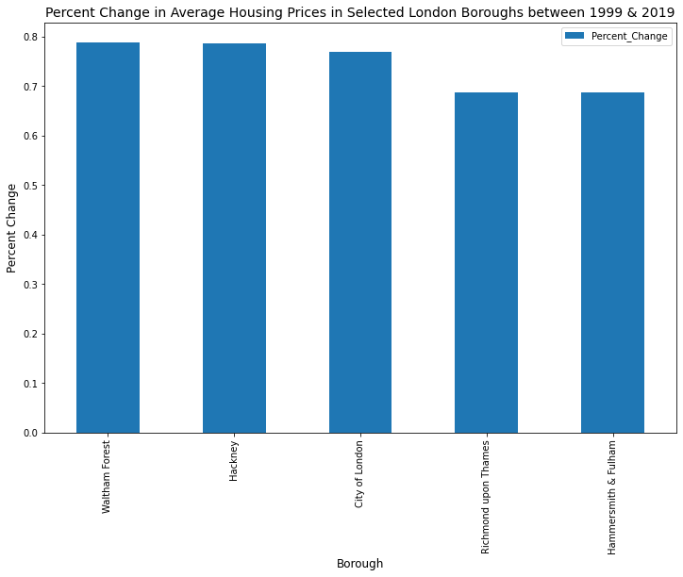
Both Ends of the Spectrum
Notes:
Boroughs with the highest percentage change and the lowest percent change
Starting and ending price points were variable between both ends of spectrum

Slide 10
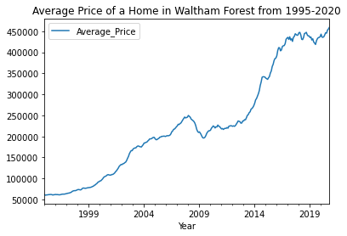
Conclusions
Waltham Forest
Hackney
79%
in two decades

Slide 11
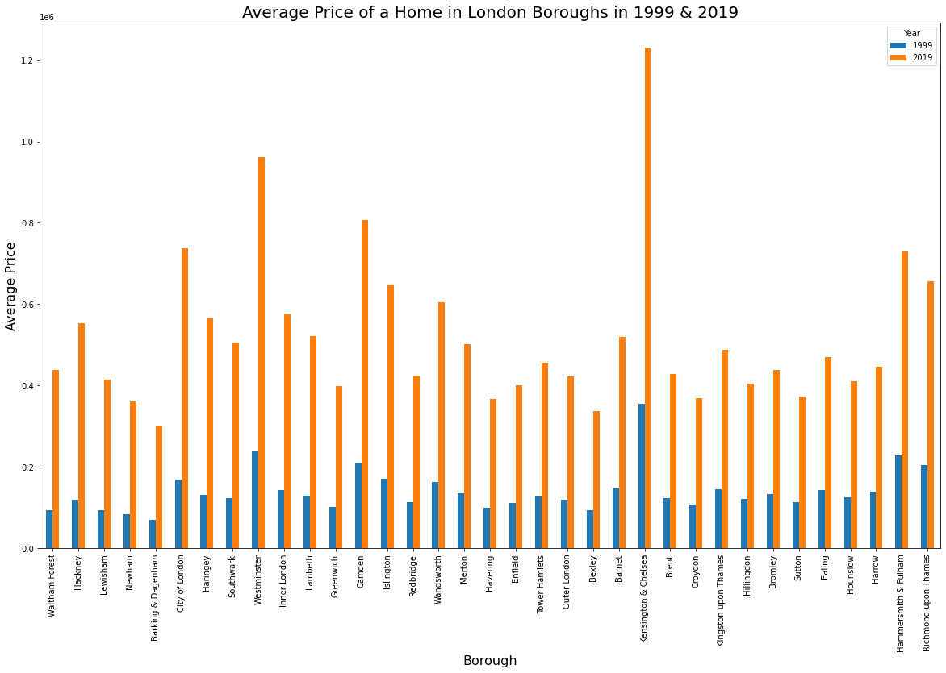
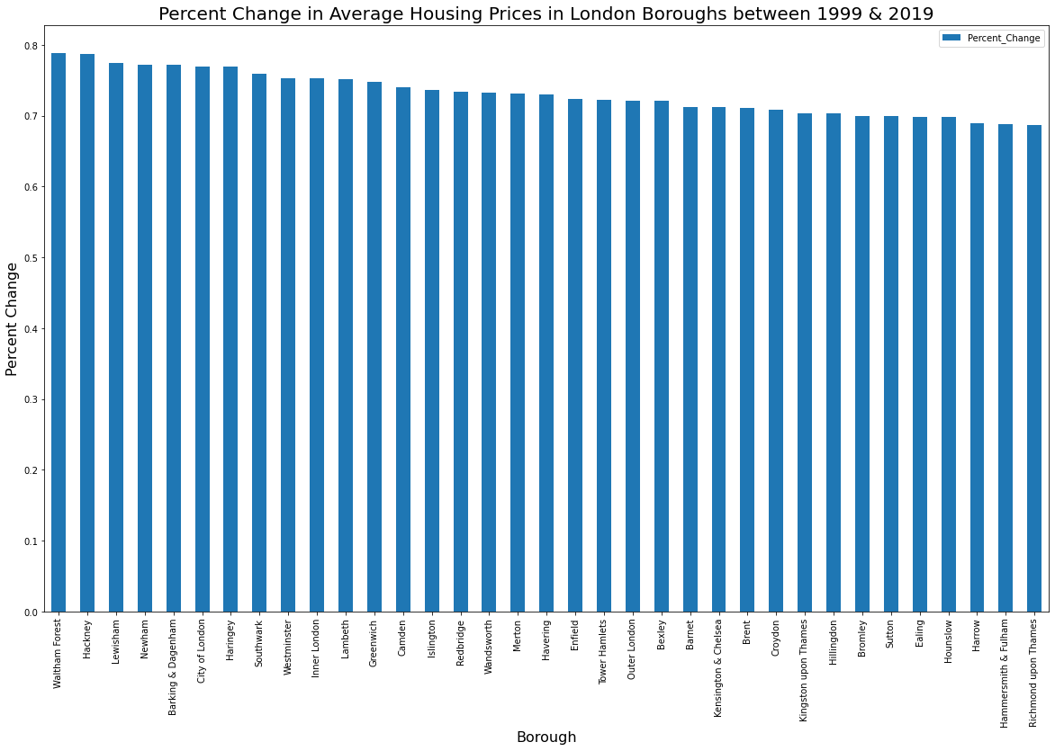
Variability across London Boroughs
Statistic | Average Price Percent Change
Mean | 0.7316
Standard Deviation | 0.029916
Minimum | 0.687
25% Quartile | 0.7065
50% Quartile | 0.73
75% Quartile | 0.753
Maximum | 0.789
Notes:
X-axis on both graphs follows the same sequence, there isn’t a clear trend of magnitude of starting and ending points and how much % change there was in the market

Slide 12
“Which boroughs of London have seen the greatest increase in housing prices, on average, over the last two decades?”
Notes:
Boroughs on the east side of the city seem to be seeing prices increase at a faster pace in the last two decades

Slide 13
Further Analysis
Identify Causes & Impacts of Varying Rates
Age of properties
Public Transit Accessibility
Gentrification
Demographic changes
Crime rates
Analysis Extension
Trends in rental market
Trends in other large cities
Predicting prices in next 10 years

